Slide 1

Exploratory Data Analysis
G2M insight for Cab Investment firm
Intern: Samuel Cueva Lozano
26/06/2021

Slide 2
Agenda
Executive Summary
Problem Statement
Approach
EDA
EDA Summary
Recommendations

Slide 3
Executive Summary
The Client
XYZ is a private firm in US. Due to remarkable growth in the Cab Industry in last few years and multiple key players in the market, it is planning for an investment in Cab industry and as per their Go-to-Market(G2M) strategy they want to understand the market before taking final decision.
Problem Statement
There are two cab companies which XYZ wants to invest in, so they require actionable insights to help them identify the right company to make their investment.
Cab Companies:
Yellow Cab
Pink Cab
Analysis:
EDA
Descriptive Analysis.
Correlation Analysis.
Contextual Analysis.
Recommendations.

Slide 4
Approach and Assumptions
Duplicate values
A record in the data set will be considered duplicate if there is a transaction with the same kilometers traveled, the same city, the same company and the same day.
Join tables
The table Cab_Data.csv will be joined with the table Customer_ID.csv by the table Transaction_ID.csv since the latter has the Transaction ID (from Cab_Data.csv) and Customer ID (from Customer_ID.csv) attributes, then the table City.csv will also join them.
Null values
The Empty values, NaN values and values like “?” will be treated as Null values
Fields with too many null values would be removed or filled according to the following:
Fields like Age, Gender, Income, Company and Users would be filled because they have missing values that depends on their hypothetical values or depend on other attributes.
The rest of fields would be removed because they have missing values due to bad configuration, issues with data collection, or untraceable random reasons.
After cleaning at the field level, rows with null values would be removed.

Slide 5
Approach and Assumptions
Outlier detection
Outliers will be removed from numerical fields so that they don’t negatively affect the analysis.
A fixed threshold would be used for the Age, Population and Users attribute to avoid inconsistent data, then the IQR Score will be used to filter out the outliers in all attributes.
Data Transformation
The field Date of Travel from the table Cab_Data.csv could be transformed to a more readable format for better understanding.

Slide 6
Exploratory Data Analysis
Descriptive Analysis
Correlation Analysis
Contextual Analysis

Slide 7
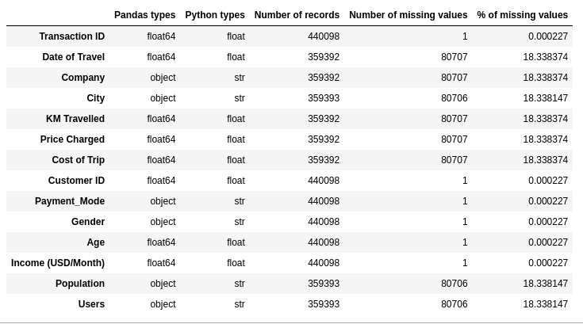
Data
There are four datasets :
Cab_Data.csv – this file includes details of transaction for 2 cab companies
Customer_ID.csv – this is a mapping table that contains a unique identifier which links the customer’s demographic details
Transaction_ID.csv – this is a mapping table that contains transaction to customer mapping and payment mode
City.csv – this file contains list of US cities, their population and number of cab users
Location: https://github.com/DataGlacier/DataSets

Slide 8
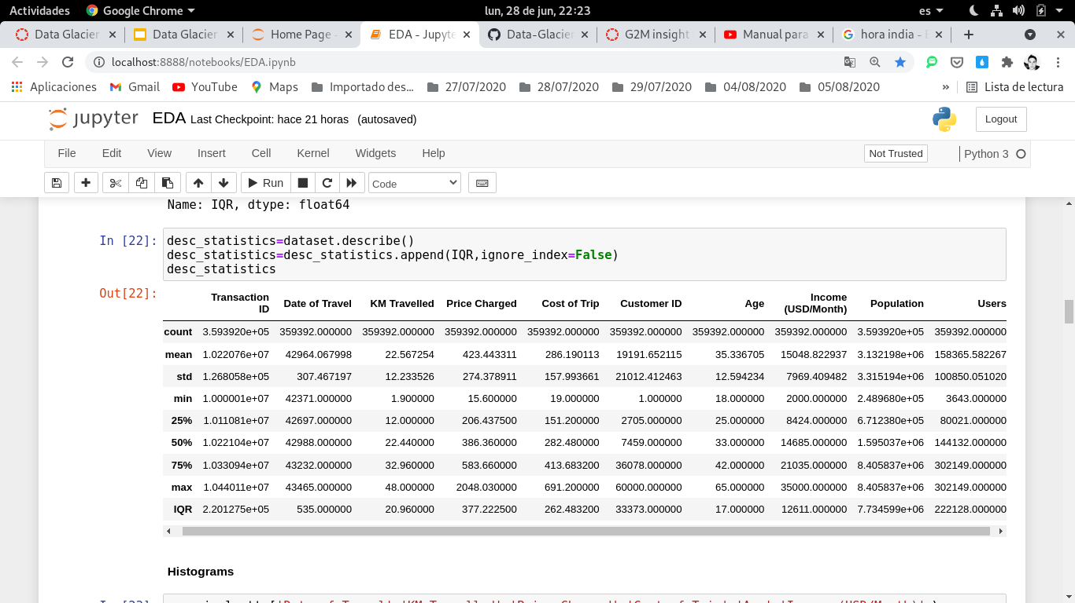
Descriptive Analysis

Slide 9
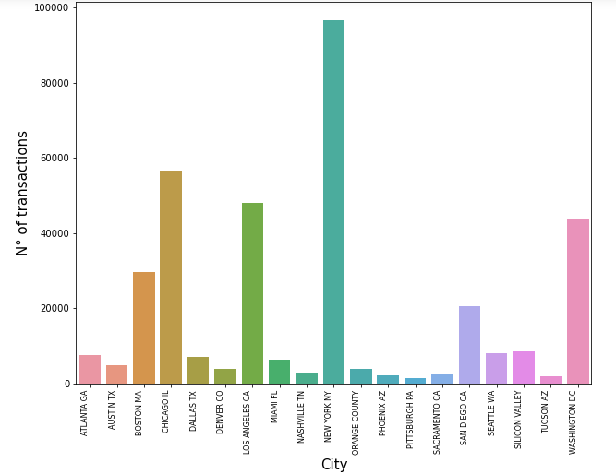
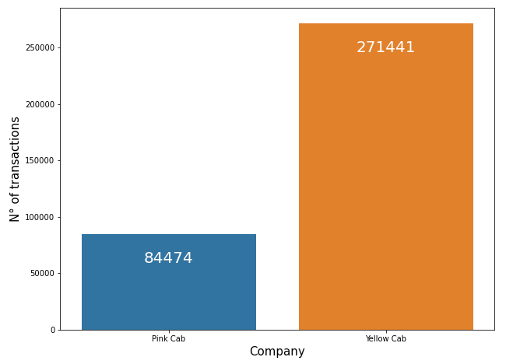
Descriptive Analysis
It can be seen that the number of total transactions in Yellow Cab is much larger than Pink Cab
There is a greater number of transactions in cities like New York, Chicago, Los Angeles, Washington DC and Boston.

Slide 10
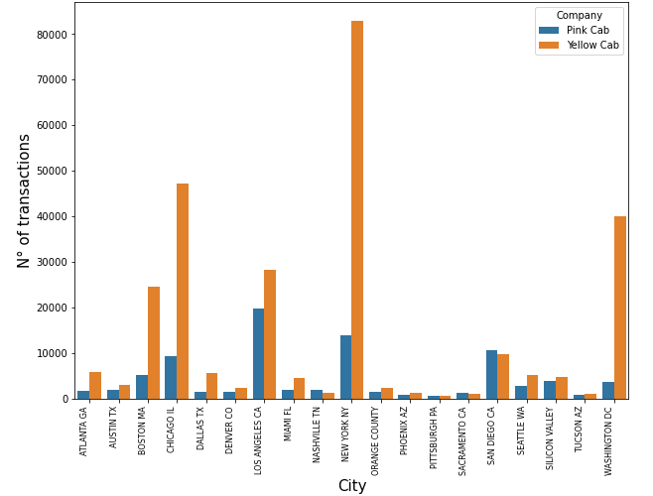
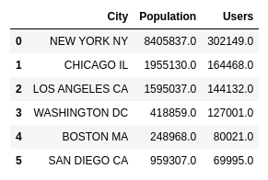
Correlation Analysis (categorical vs categorical)
The Yellow Cab company has a higher number of transactions in the 5 cities with the most population and the most taxi users.
The Pink Cab company competes with company Yellow Cab in number of trips (transactions) in cities such as: Los Angeles and San Diego and only has a higher number of transactions in San Diego.

Slide 11
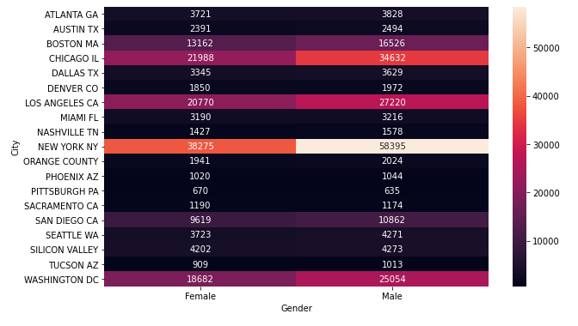
Correlation Analysis (categorical vs categorical)
It shows that there are more transactions carried out by men compared to women in cities with more users and with more population(New York,Chicago,Los Angeles,Washington and Boston)

Slide 12
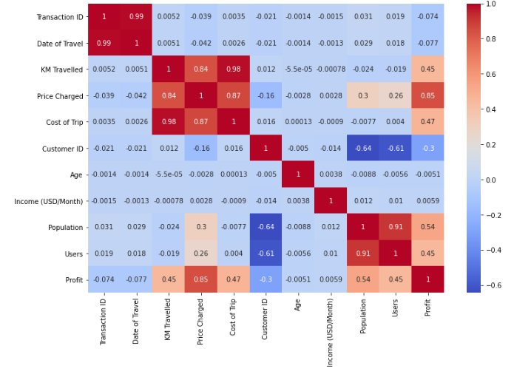
Correlation Analysis (Numerical vs Numerical)
The variable Profit will be added to improve the analysis, this variable these would be used if an ML model is built.
Using the Heat map above, the following can be observed:
The variables Population and Users are strongly correlated, so Population would be discarded to build the model.
The new variable Profit is strongly correlated with the variables Price Charged as expected.
The new variable Profit has a moderate positive correlation with KM Travelled, Cost of Trip.
Transaction ID and Customer ID are unique identifiers, they would not be used when building the ML model,but they can be used in Contextual Analysis.
the variable Income and Age have no correlation with the objective, so these would be discarded or transformed to build the model, they can be used in Customer Analysis.
KM Travelled and Cost of Trip are strongly correlated, so KM Travelled would not used when building the ML model, however if a Neural Network is used as algorithm this feature could be considered.

Slide 13
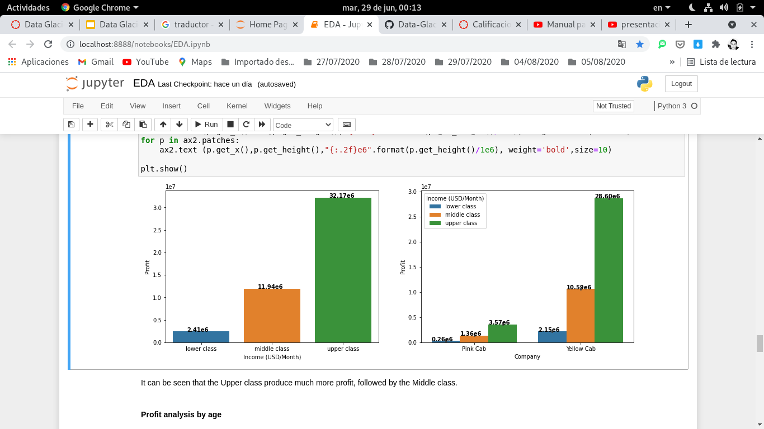
Correlation Analysis(Categorical vs Numerical)
Income class-wise profit analysis
It can be seen that the Upper class produce much more profit, followed by the Middle class.

Slide 14
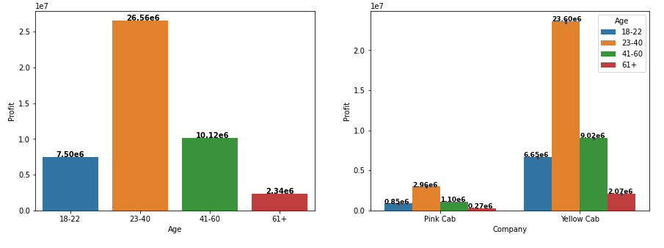
Correlation Analysis(Categorical vs Numerical)
Profit analysis by age
The segment of customers from 23 to 40 years is the one that generates the most profit in both companies

Slide 15
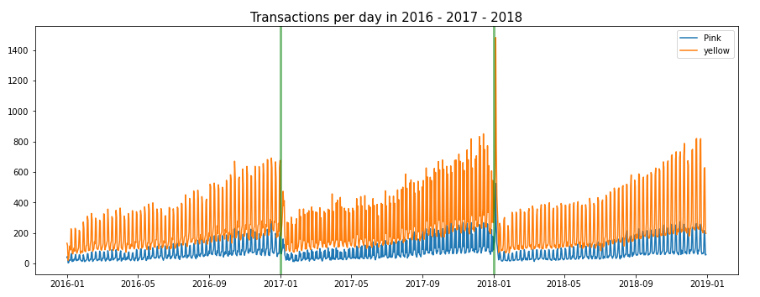
Contextual Analysis
2016
2017
2018
It can be seen that the higher consumption of the service in both companies increases as the year progresses, with the month of December being stronger.
Company Yellow has more consumption of its service at each stage of the year.

Slide 16
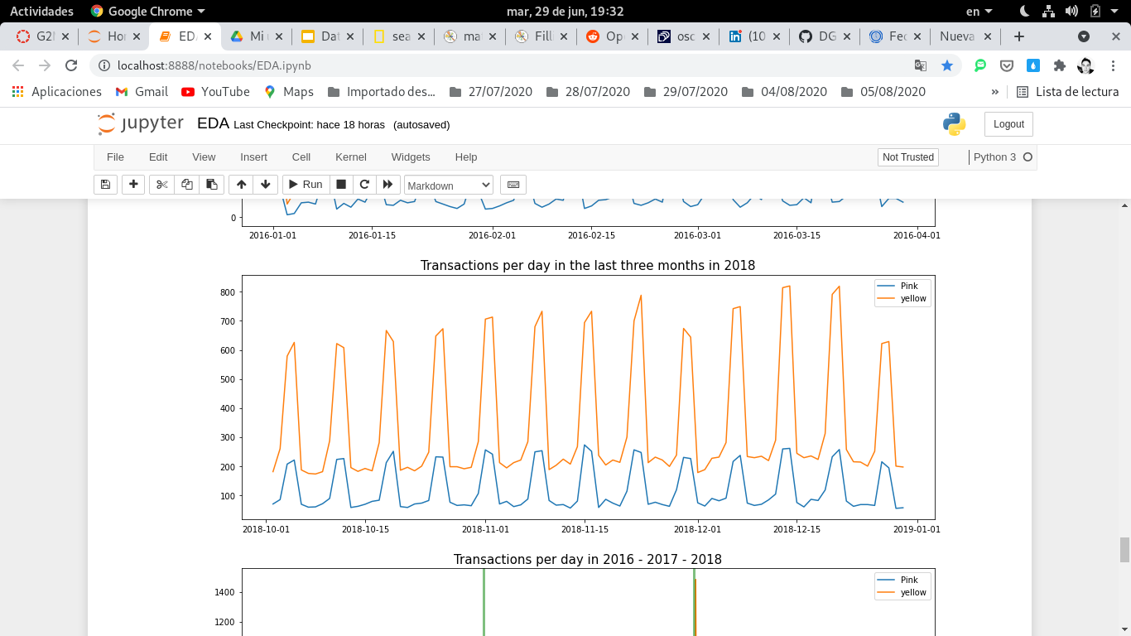
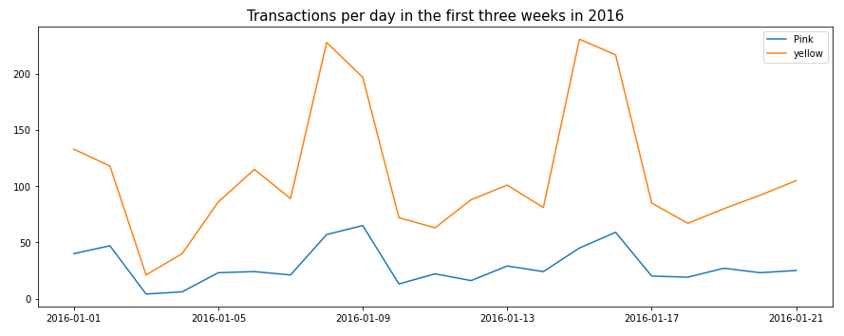
Contextual Analysis
It can be seen that the highest consumption of the service occurs on weekends (especially Friday and Saturday) and that on weekdays consumption is minimal, this pattern is repeated every week throughout the year and both companies

Slide 17
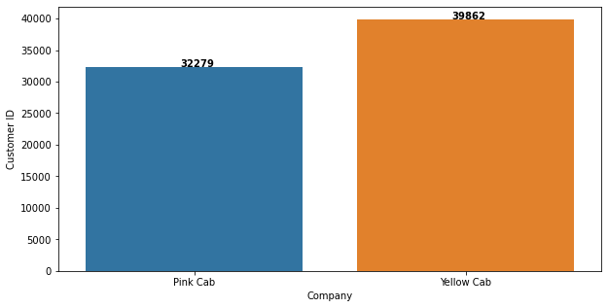
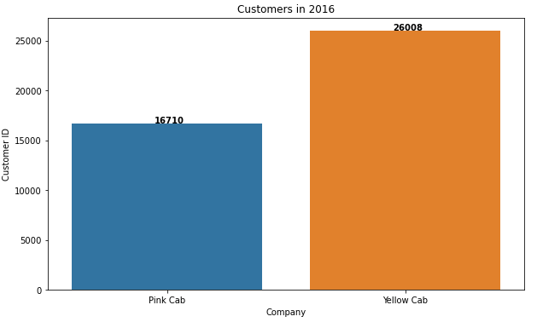
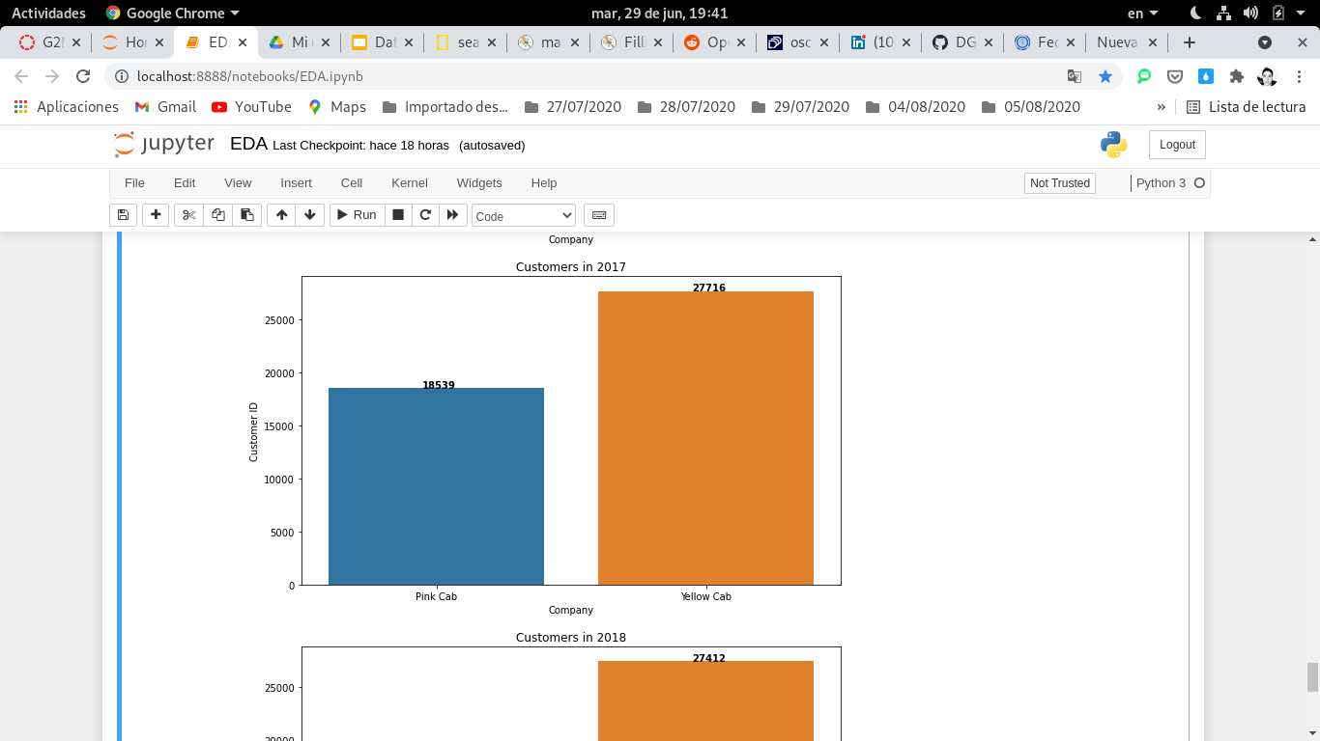
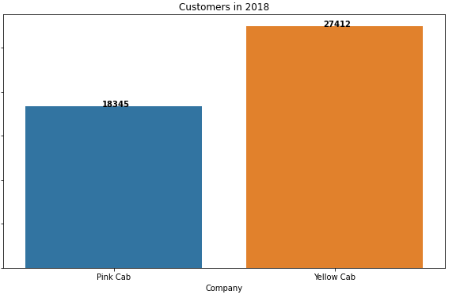
Contextual Analysis
Total number of customers : 46104
The total number of clients of company Yellow is slightly higher than that of company Pink, which means that many of the users of company Yellow also use company Pink.
The number of Yellow Cab customers is greater than the number of Pink Cab customers in each year.

Slide 18
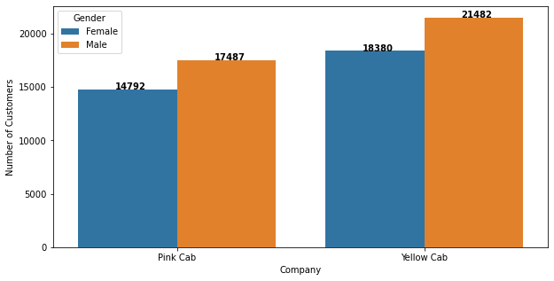
Contextual Analysis
The number of male customers is greater than the number of female clients, but this occurs in both companies

Slide 19
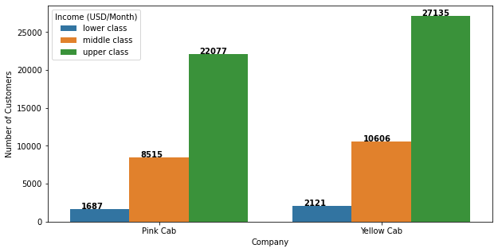
Contextual Analysis
Upper-class clients are the ones that consume the most of the service and both companies have a greater number of clients in this sector.

Slide 20
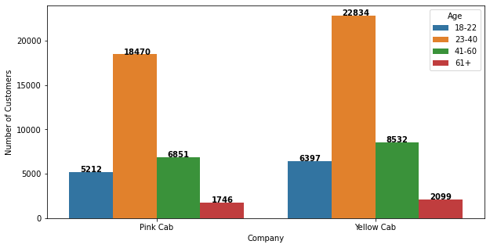
Contextual Analysis
The group of clients from 23 to 40 years old is the one that most consumes the service and both companies have their largest number of clients in that group.

Slide 21
EDA Summary and Recommendations
Presence in big cities : Yellow Cab has a greater market share than Pink Cab in the largest cities in the United States(New York,Chicago,Los Angeles,etc).Therefore, it is already well positioned in these cities and has a large number of potential clients since these cities have a large population.
Demand throughout the year :Yellow Cab has a greater demand for its service than Pink Cab at each time of the year and in each year(2016,2017,2018).
Number of customers: Yellow Cab has a greater number of clients in general and year after year that has not changed much.
Profit according to customer income: Both companies cover well the segment of clients with high income, which are the ones that generate the greatest profit, even so, Yellow Cab has more clients in that segment.
Profit according to the age of the client: The segment of customers aged 23 to 40 years are the ones that generate the most profits, and specifically in this segment is where there is the most difference in favor of company Yellow Cab.
Based on all the findings mentioned above, the recommendation is to invest in the Yellow Cab company.

Slide 22
Thank You

